Slide 1
Variations of DES 1. Double DES 2. Triple DES

Slide 2
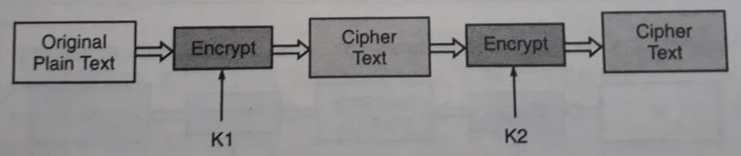
Double DES Encryption

Slide 3
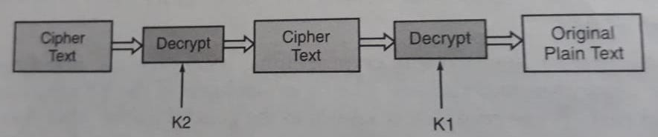
Double DES Decryption

Slide 4
Meet-in-the-middle Attack on Double DES (1/4)
If we use two different keys of n-bit each, the cryptanalyst would need 2^{2n} attempts to crack the key.
But Merkle and Hellman introduced the concept of the meet-in-the-middle attack, which involves encryption from one end, decryption from another end and matching the results in the middle, hence the name meet-in-the-middle attack.

Slide 5
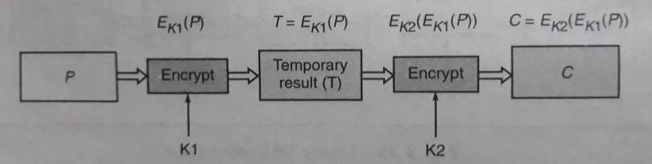
Meet-in-the-middle Attack on Double DES (2/4)
Mathematically Double DES can be expressed as follows:
Here, we assume that the cryptanalyst knows a plain text block P and the corresponding final cipher text block C.

Slide 6
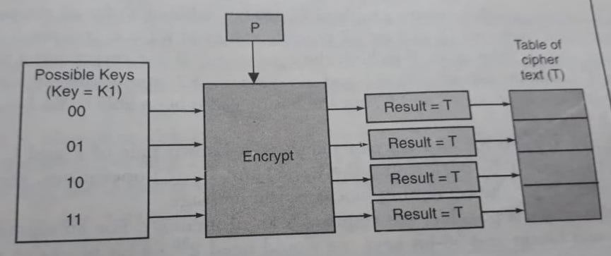
Meet-in-the-middle Attack on Double DES (3/4)
Conceptual view of the cryptanalyst’s encrypt operation

Slide 7
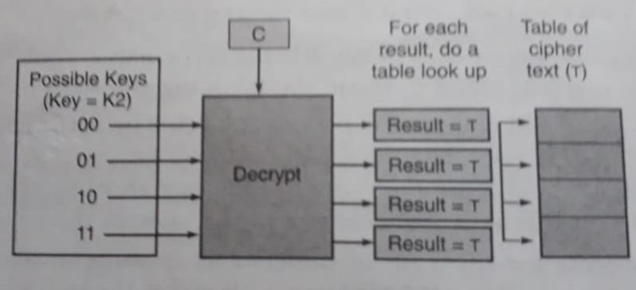
Meet-in-the-middle Attack on Double DES (4/4)
Conceptual view of the cryptanalyst’s decrypt operation

Slide 8
Triple DES
Triple DES is DES – three times.
It comes in two flavours:
One that uses three keys
The other that uses two keys

Slide 9
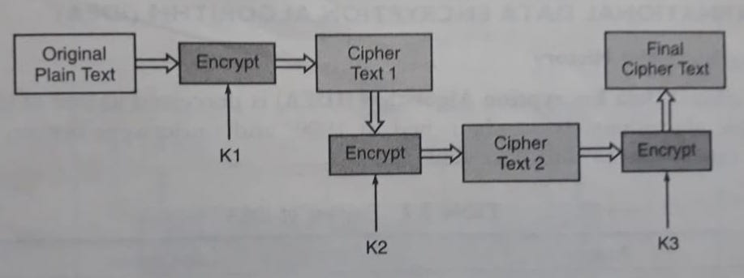
Triple DES with Three Keys

Slide 10
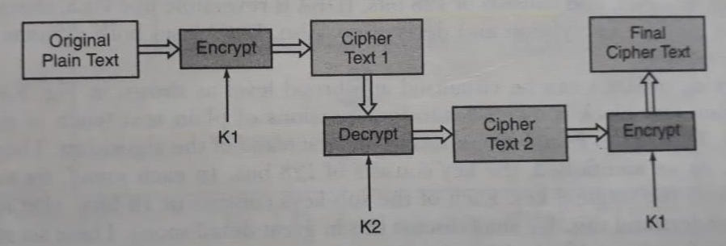
Triple DES with Two Keys

Slide 11
Next Topic
Advanced Encryption Standard
(AES)

Slide 12
Thank You

